Slide 1
Drug information
Here is where your presentation begins
By: Dr. Riffat Ibrahim Riffat

Slide 2

Where can the pharmacist work?
A pharmacist can work in many places such as:
Community Pharmacy
Clinical Pharmacy
Hospital Pharmacy
Industrial pharmacy
Academic Pharmacy
Research and development
Herbal Pharmacy .
Drug information centers

Slide 3

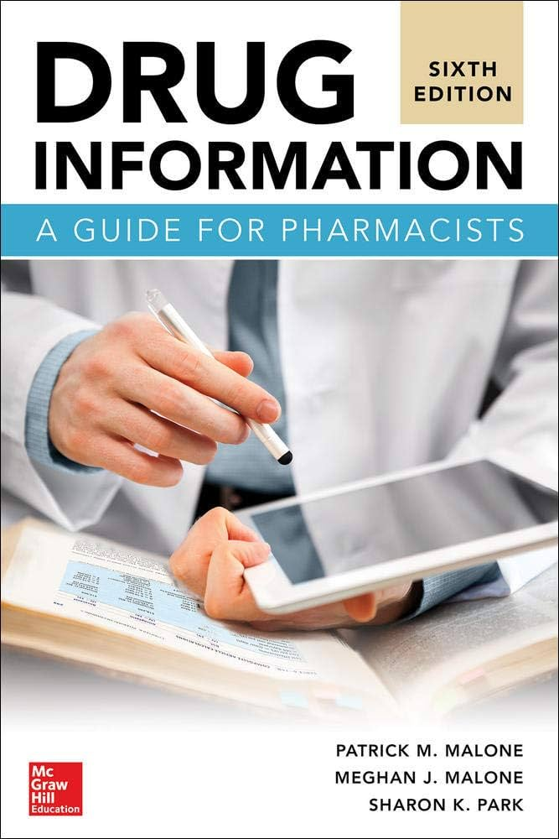
Drug information center (DIC)
A service unit that is operated by trained healthcare professionals who are committed to providing drug information as it relates to therapies, education ,pharmacoeconomics and research programs.

Slide 4

Drug information center (DIC)
History:
  First DIC was developed in University of Kentucky in 1960.
  In United states 80% of the Hospitals having DIC.
  Egyptian drug information center (EDIC) establishment was organized in 2012

Slide 5
Importance of DIC:
Access to medical information by health care team is facing some problems:
  Getting information from textbooks is time consuming and textbooks themselves are expensive and may be outdated
  Most free websites are not credible
  Information about drugs from pharmaceutical companies maybe biased.

Slide 6

thus the demand for rapid, credible and accurate drug information increased.
WHO supports independent DIC as a core component of national programs to promote better healthcare to all.

Slide 7

Requirements for DIC
Team
Place and hardware
Methods of communication
Sources: The information should be properly updated and maintained.

Slide 8
The efficient use of drug information (DI) is an important skill for all pharmacists to have regardless of their practice site.
In all pharmacy settings, pharmacists are recognized as drug experts and as providers of DI. It is imperative that pharmacists know how to provide accurate and complete responses to DI requests.
Keeping current with DI resources is challenging for the clinician because of the vast amount and the variable quality of available resources.
Technology has also brought DI to the patient’s bedside. Pharmacists should know what DI resources are available and be able to use these sources effectively and efficiently.

Slide 9
Pharmacists are being asked daily to provide responses to numerous drug information requests for a variety of people.
It is tempting just to select the easiest, most familiar new resources to find information, however by doing that there is the possibility of missing new resources or limiting the comprehensiveness of information found.

